Slide 1
Geography of India

Slide 2
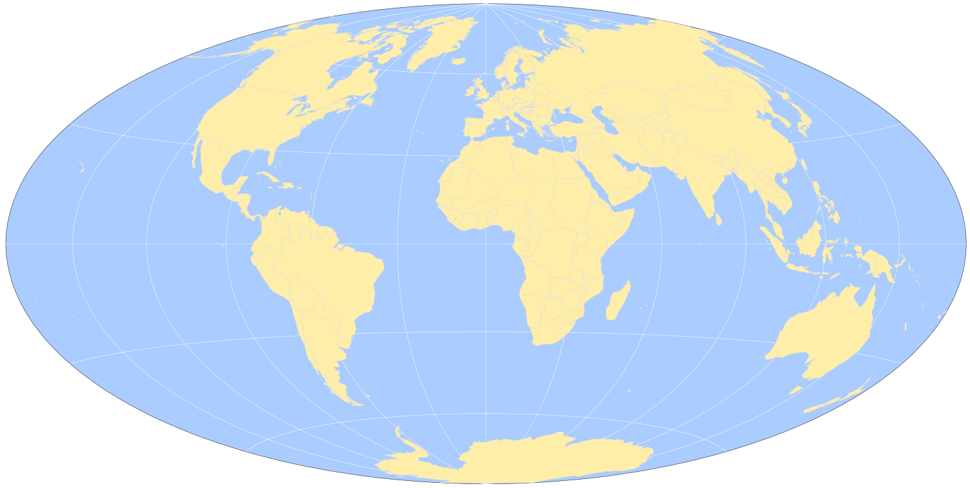
What Continent is India on?

Slide 3
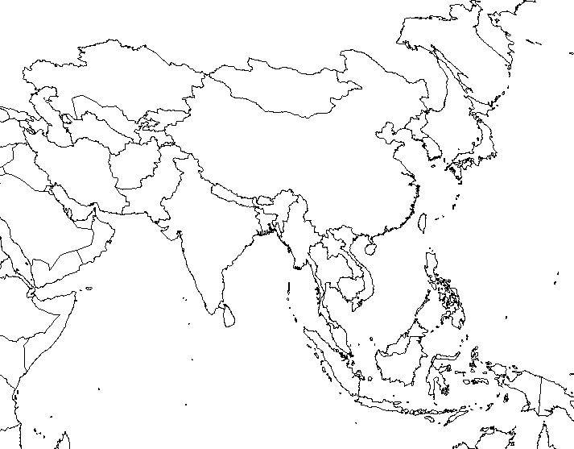
Where in Asia is India Located?

Slide 4
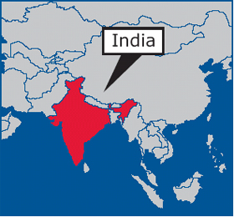
India

Slide 5
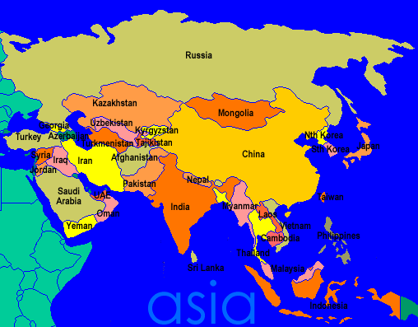
India

Slide 6
Physical Features
India Is a Subcontinent.
A Subcontinent is a large landmass that is smaller than a continent.
There is a wide variety of landscapes across the Subcontinent that include Mountains, Rivers and Plains.

Slide 7
Mountain Ranges
Huge mountain ranges separate the Indian Subcontinent from the rest of Asia.
The Rugged Hindu Kush Mountains in the northwest divide the subcontinent from Central Asia.

Slide 8
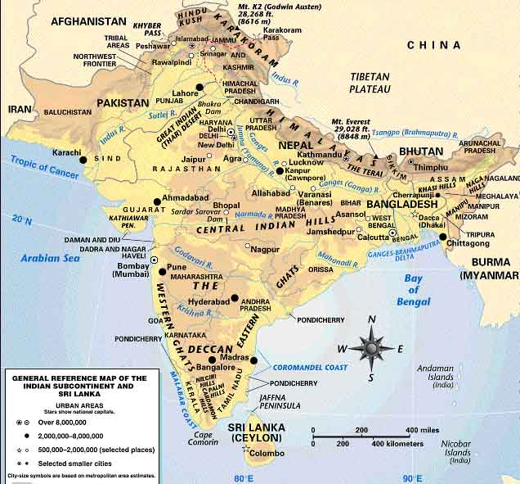
Hindu Kush Mountains

Slide 9
Western and Eastern Ghats
Eastern and Western Ghats are low mountains that separate India's East and West coasts from the country’s interior.

Slide 10
Western and Eastern Ghats

Slide 11
The Himalayas
Perhaps the most impressive physical features in the Subcontinent, however, are the Himalayas.
These enormous mountains stretch about 1,500 miles along the northern border of the Indian Subcontinent.
How far is 1,500 miles?
Starting in Grand Rapids and going south how far is 1,500 Miles?

Slide 12
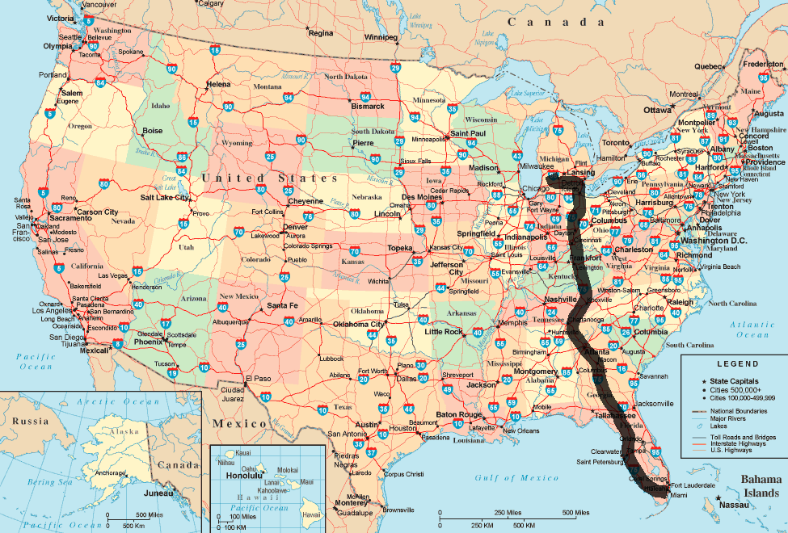
1500 Miles

Slide 13
Himalayas
These mountains are formed by the collision of two massive tectonic plates, the Himalayas are home to the world’s highest mountains.
On the border between Nepal and China is Mount Everest.
The Highest mountain on the planet it is 29,000 feet tall.

Slide 14
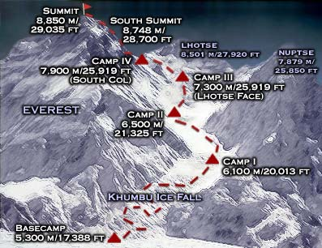

Slide 15
Himalayas

Slide 16
Rivers and Plains
Deep in the Himalayas are the sources of some of Asia’s Mightiest rivers.
The Ganges
The Indus
Each carries massive amounts of water from the mountains’ melting snow and glaciers.
For thousands of years, these rivers have flooded the surrounding land, leaving rich soil deposits and fertile plants.

Slide 17
Climate
A variety of Climates and natural resources exist throughout the region.

Slide 18
Activity
Read the section on Climate Regions Page 545
Create a Climate Map
Complete the map using page 544, as a reference.
Make sure to define Monsoon, and include the arrows on the map.
Make sure to include a key for your map.

